Slide 1
NLP: Sentiment Analysis
Analyzing Product Sentiments from Tweets
Sung Bae

Slide 2
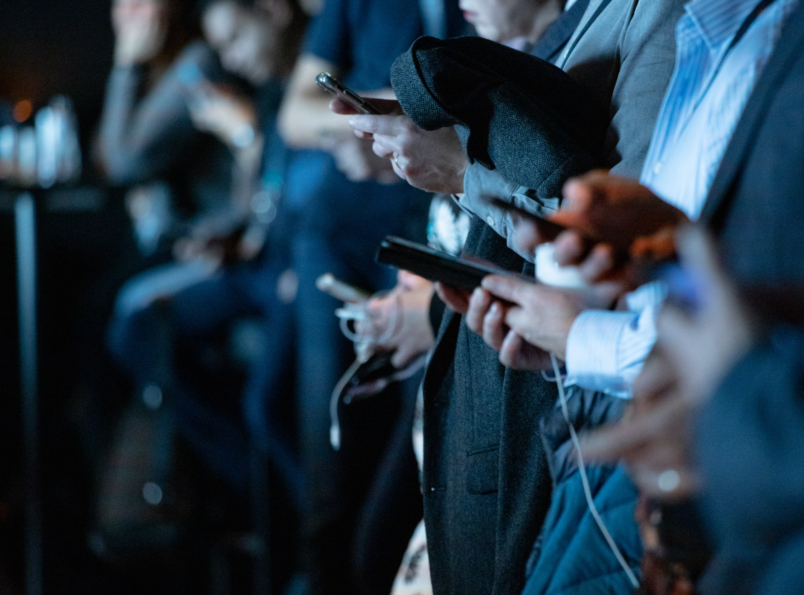
The Evolution
of
Communication
Contents
Methodology
Range
Ancient Age
Cave paintings, smoke signal, visual signals
Analog Age
Newspaper, radio, telegraphs
Digital Age
Email, SMS, Texts
Notes:
camilo jimenez
https://unsplash.com/photos/qZenO_gQ7QA
https://www.mobilecon2012.com/the-evolution-of-communication-through-the-centuries/

Slide 3
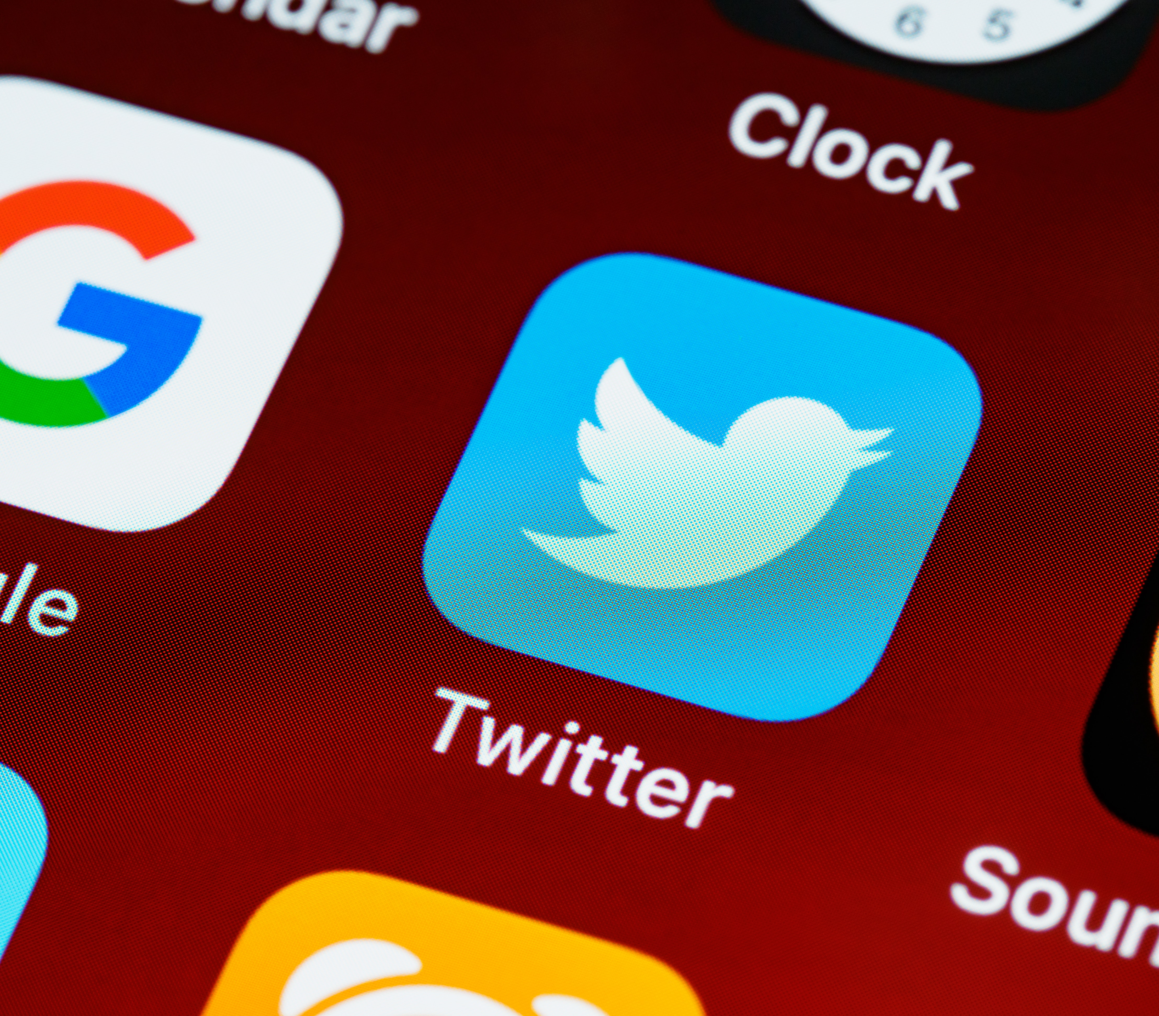
Twitter
Twitter
Importance of water
Source of life
Improve life quality
Increase school attendance
Empowers families
24 million people without basic access to safe water
Numerous organizations have been working to provide safe and accessible water
145 million daily users
22% of Americans are on Twitter
500 million tweets sent each day
65.8% of US companies use Twitter for marketing
80% of Twitter users have mentioned a brand in a tweet
77% of Twitter users feel more positive when their tweet has been replied to.
Notes:
https://unsplash.com/photos/ulRlAm1ITMU

Slide 4
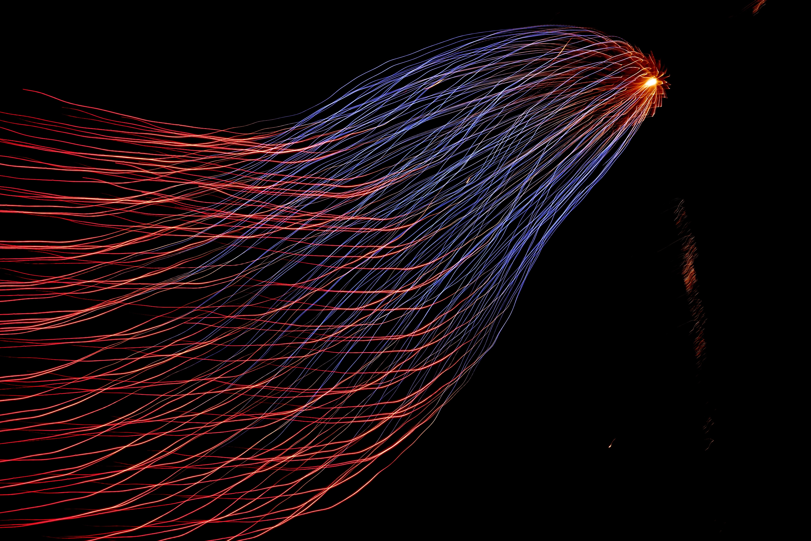
Goals
Create a model that can
[1] Flag the company when there is a negative tweet about their specific product
[2] Correctly identify which product
[3] Correctly classify tweets into negative, neutral, and positive sentiments

Slide 5
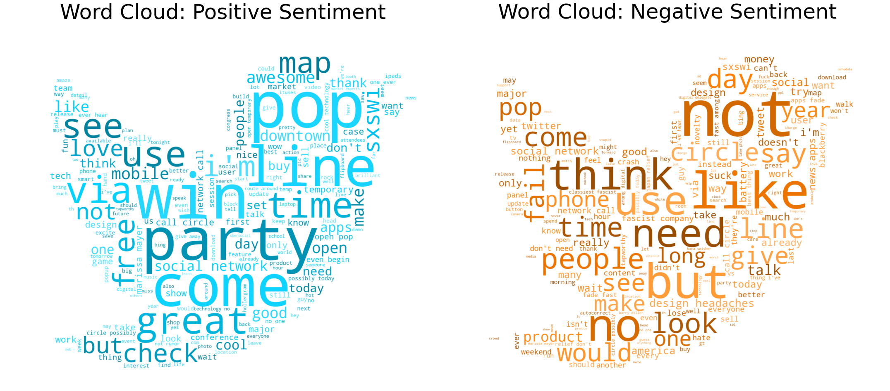
EDA: Positive and Negative Sentiments
Notes:
image source: https://blog.mellanox.com/2019/05/an-out-of-band-malware-detection-with-mellanox-bluefield/

Slide 6
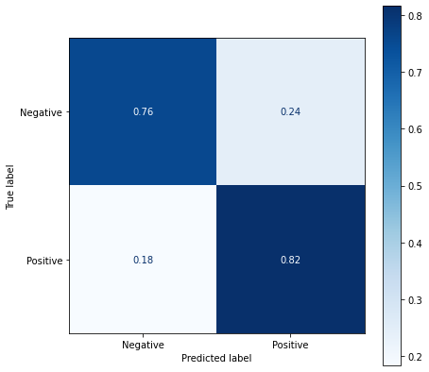
Model Results: Binary (Positive vs. Negative)
Overall Accuracy = 81 %
76% of negative sentiment
tweets were correctly identified
82% of positive sentiment
tweets were correctly identified

Slide 7
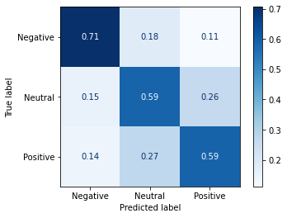
Model Results: Multiclass
Overall Accuracy = 60 %
71% of negative sentiment
tweets were correctly identified
59% of neutral sentiment
tweets were correctly identified
59% of positive sentiment
tweets were correctly identified

Slide 8
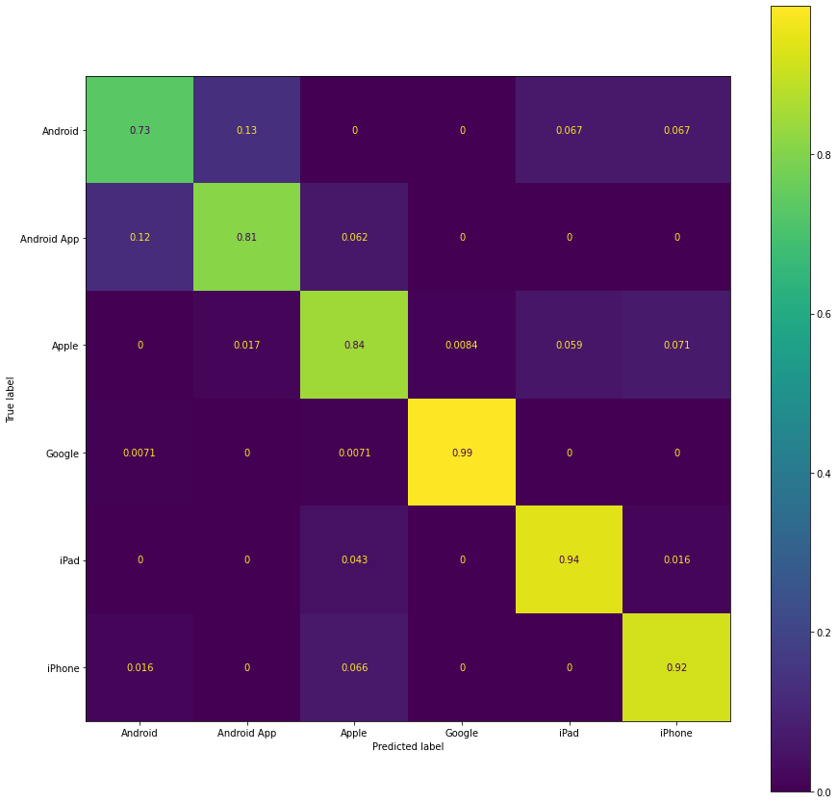
Model Results: Product Predictor
Overall Accuracy = 91 %
Comment:
Products under same brand are confused by the model
Example.
Android and Android App

Slide 9
Conclusion
Our final models can
Binary Sentiment
81% accuracy with 76% negative sentiment recall
Multiclass Sentiment
60% accuracy with 71% negative sentiment recall
Product Predictor
91% of accuracy

Slide 10
Future Direction
[1] Further data acquisition:
- Due to imbalance in data, our model suffered. Acquiring similar datasets with more balanced classes would increase our model's performance and reliability.
[2] Neutral sentiment:
- There are no true `neutral` sentiments for every statement contains certain aspect of bias toward or against something. We believe that binary sentiment with some sort of confidence score in either sentiment would work better than having multiclass sentiment
[3] Real time Twitter analysis
- Have this model refined and put in a production so that it can monitor tweets real time and analyze and negative flags about any particular product.

Slide 11
Thank you for listening

Slide 12
Appendix

